Slide 1
Best
Practices II
General principles for modeling

Slide 2
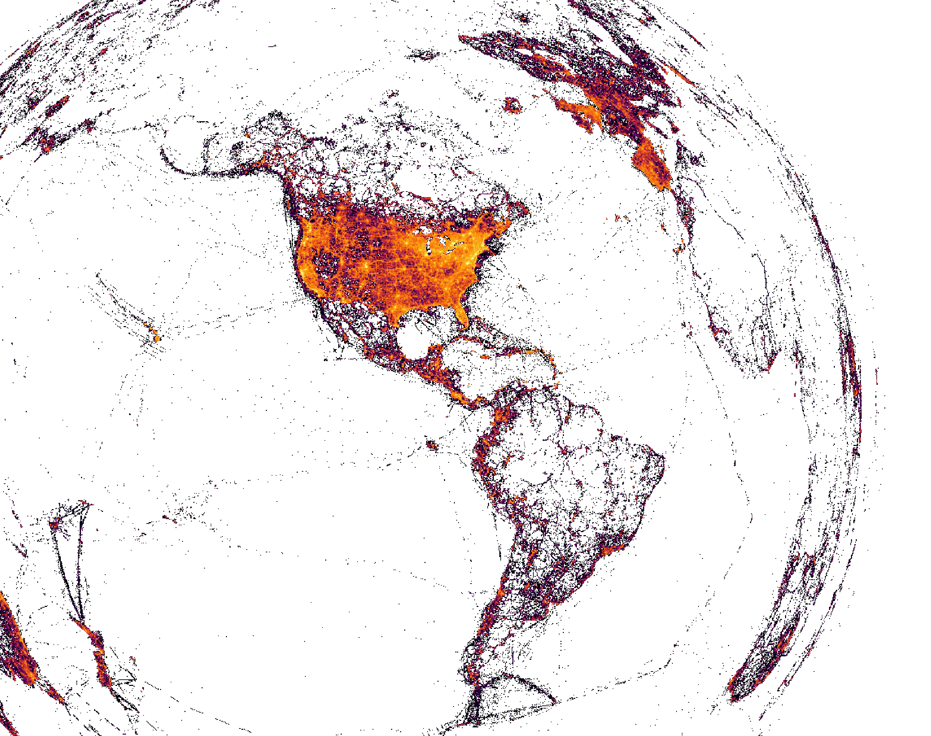

May 2019
1.2 Million checklists
20 Million observations
Total
49 Million checklists
600 Million observations
5000 Hours effort

Slide 3



Unstructured/
opportunistic
Structured surveys
Semi-structured
Standardized
observation process
Messy observation process
with effort information
Messy observation process
Kelling et al. 2019 BioScience

Slide 4
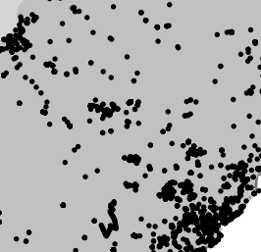

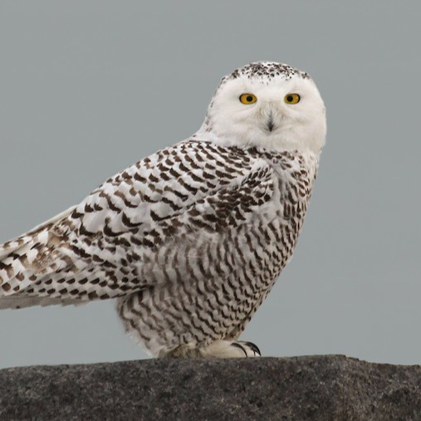

Challenges with eBird observation process
Spatial
bias
Variation
in protocol
Species
bias
Variation
in observers
FILTERING
ANALYSIS
Notes:
1. Filter/thin data to produce more structure
design-based estimates
2. Model the effects to control impact
model-based estimates

Slide 5
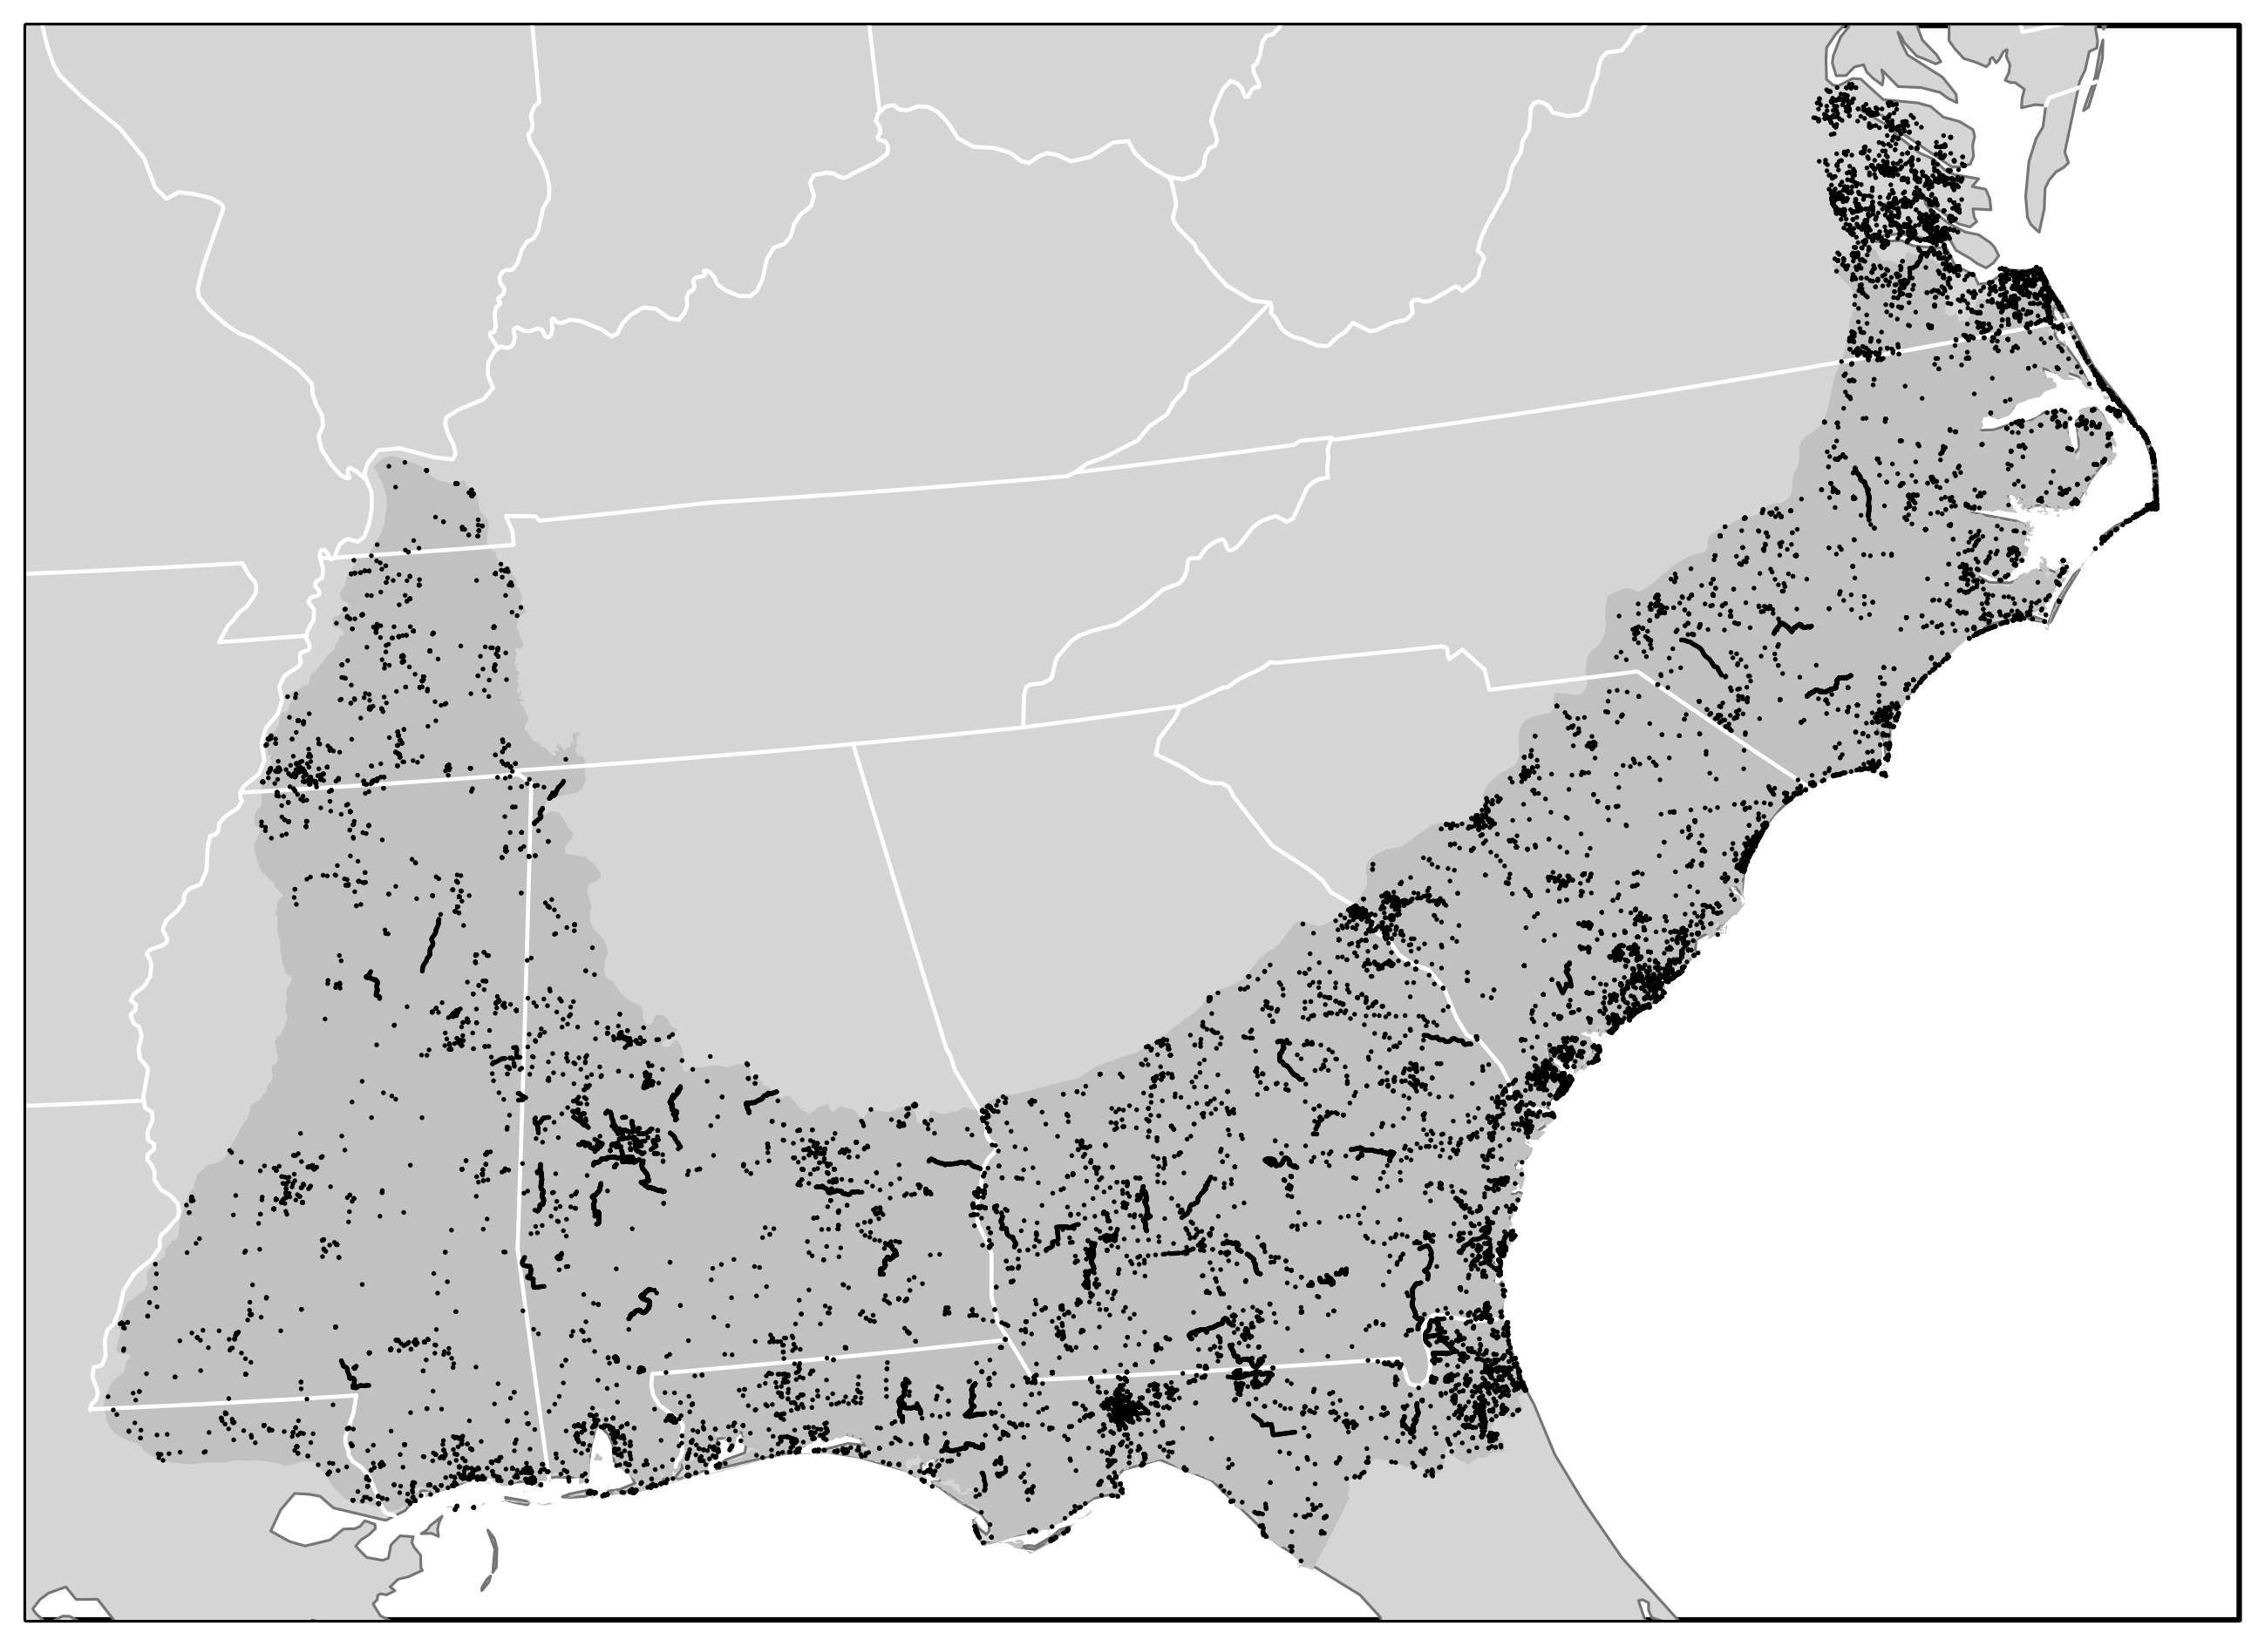
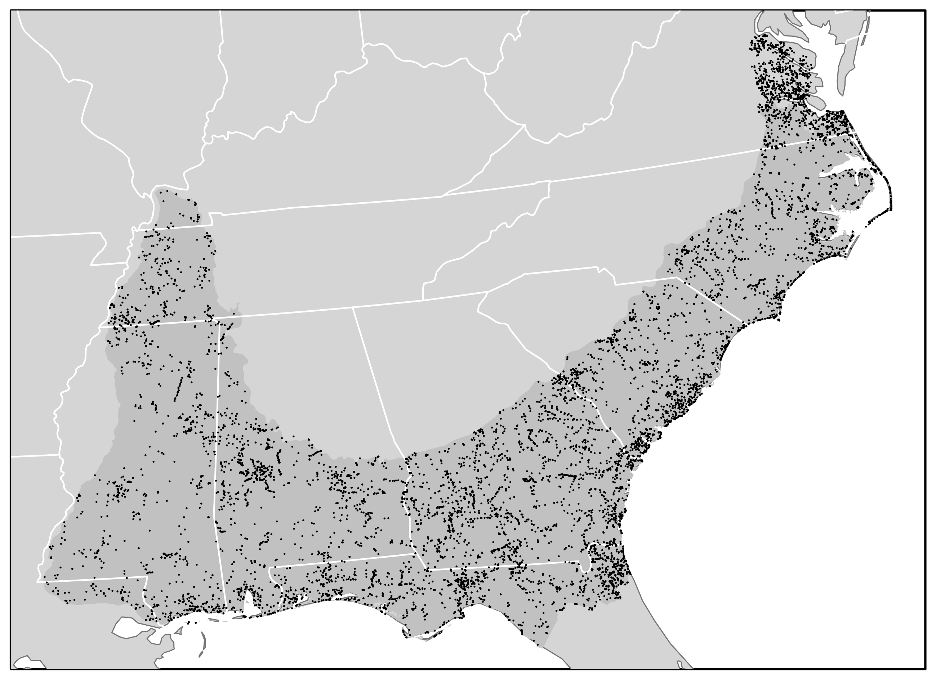
Spatial bias
June 2016 – all checklists
June 2016 – after spatial subsampling
Large scale and fine-scale spatial bias
Fine-scale spatial bias
Johnston et al. 2019 BioRXiv

Slide 6
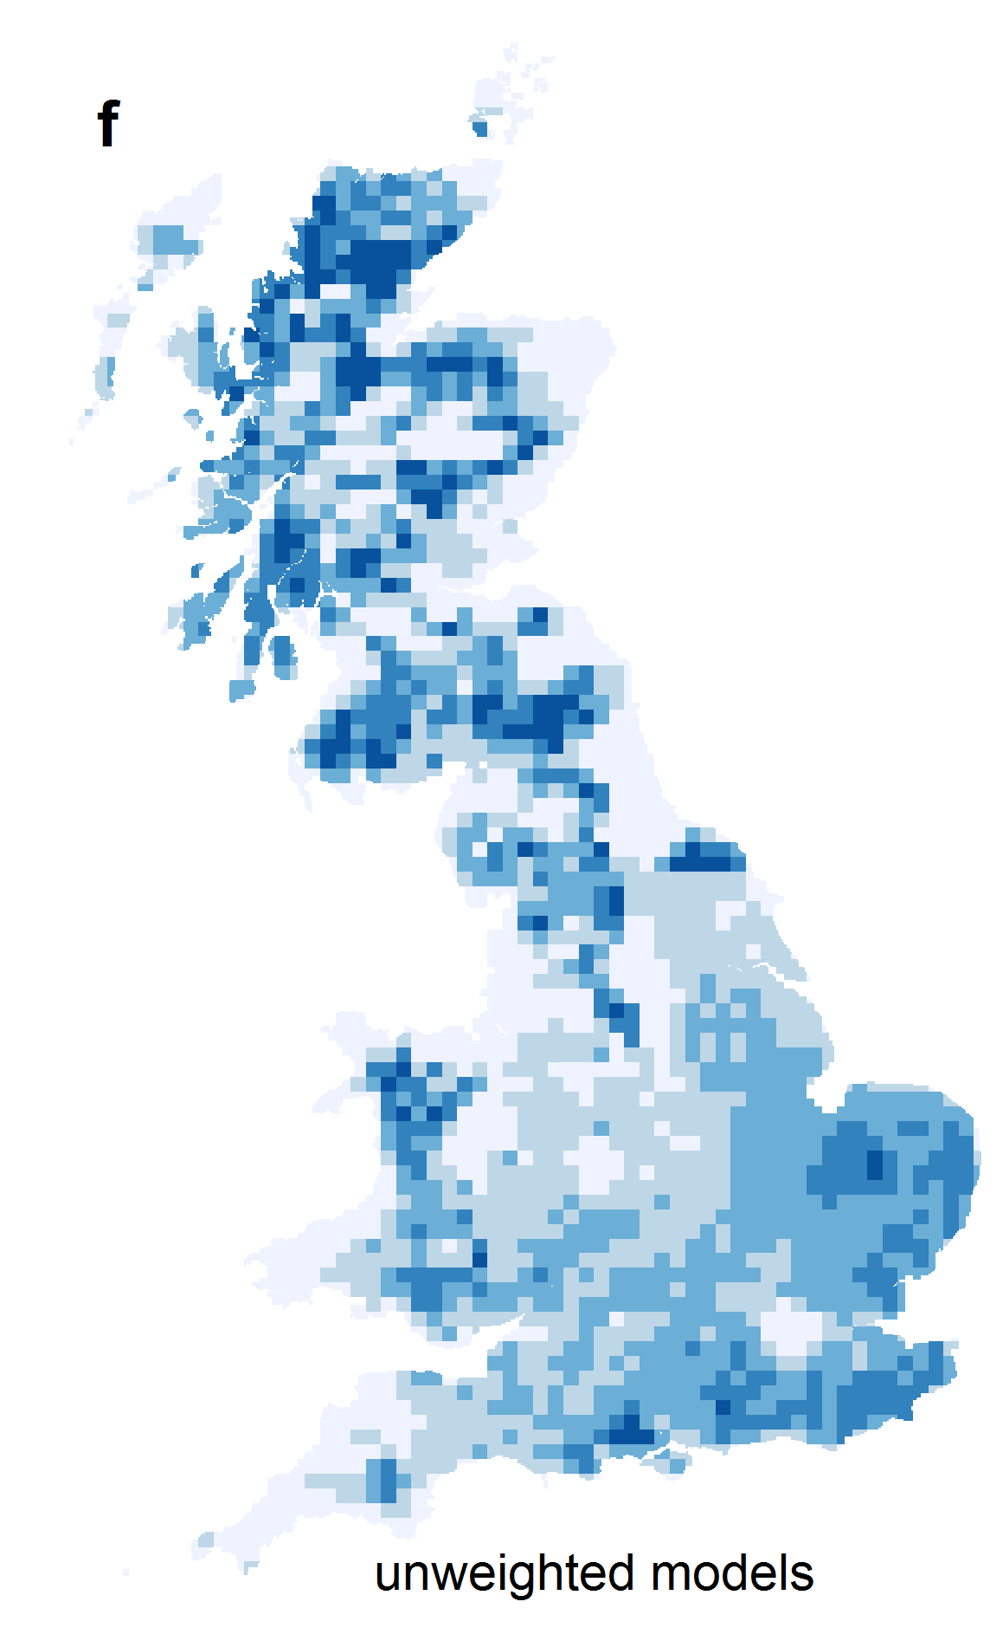
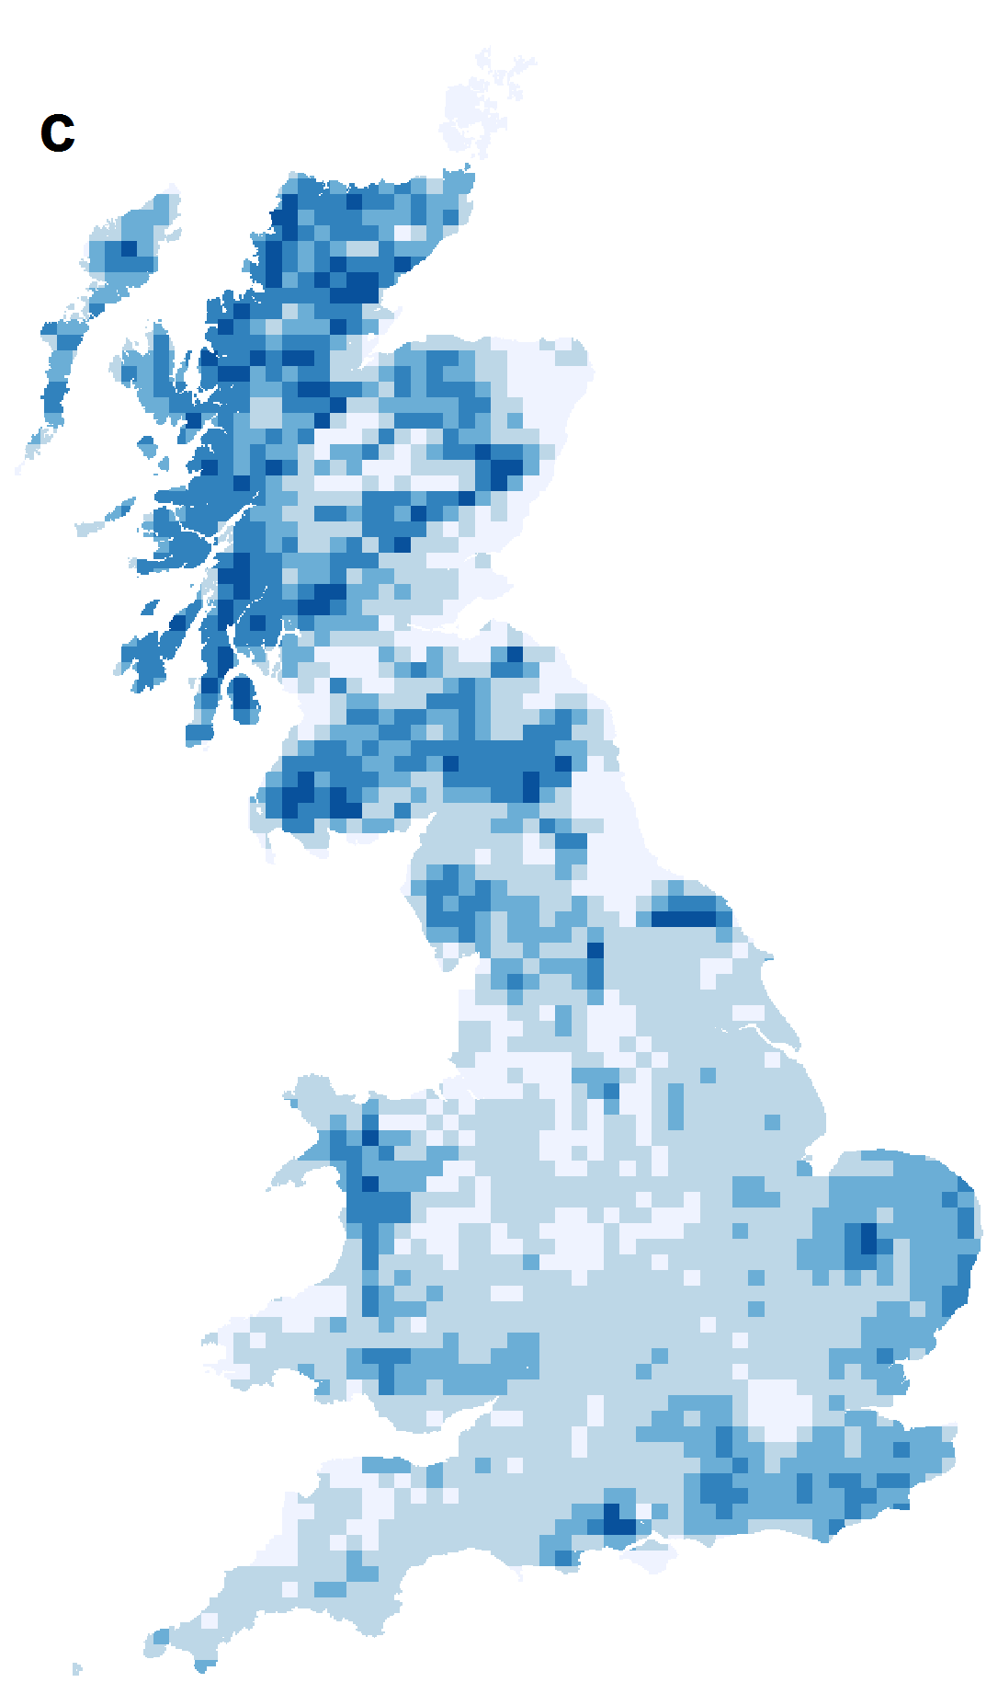
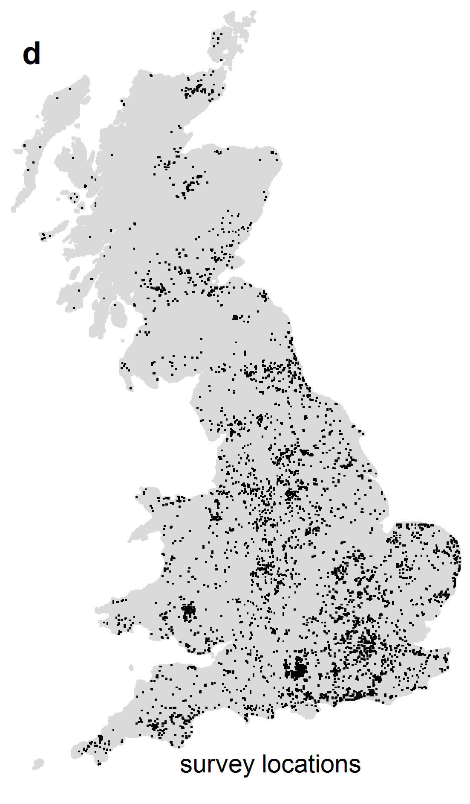
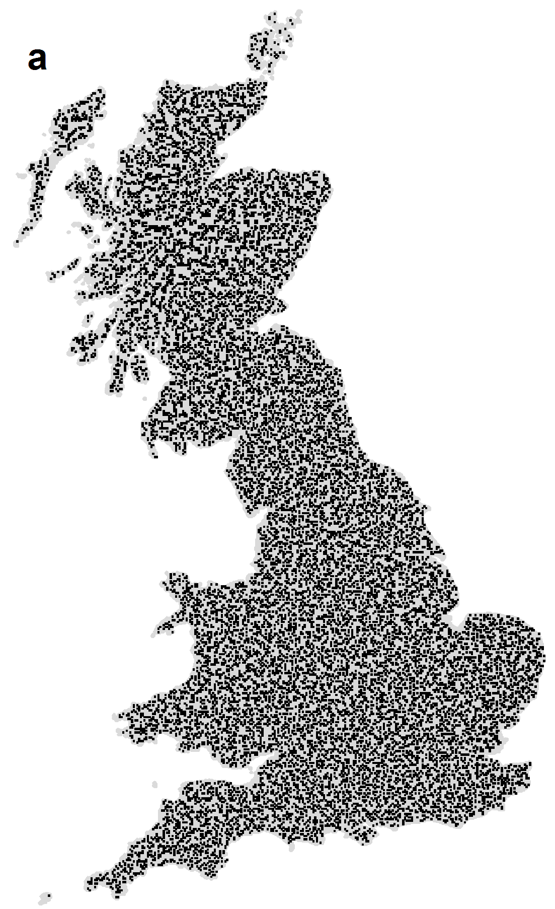
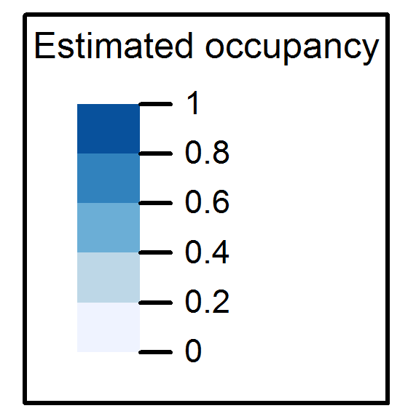
OPPORTUNISTIC DATA
STRUCTURED DATA
‘Survey’ locations
Survey locations
Johnston et al. In review

Slide 7
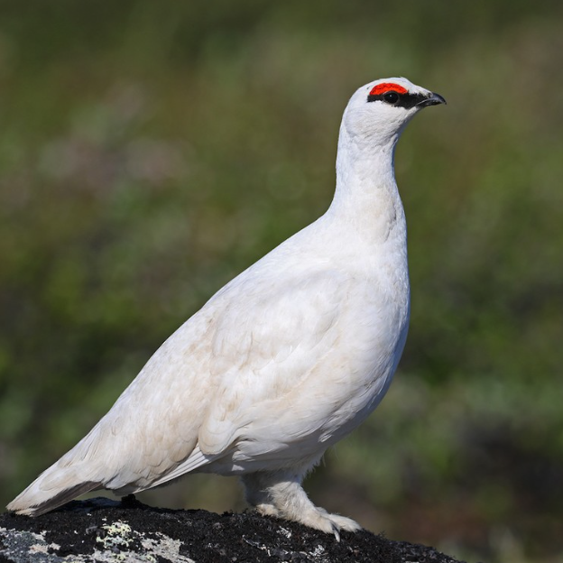
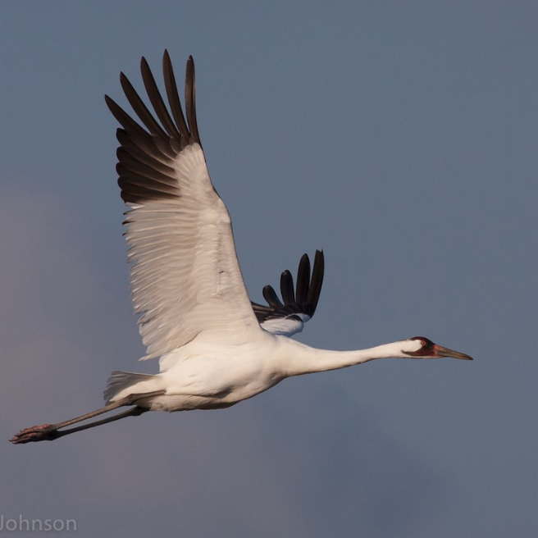

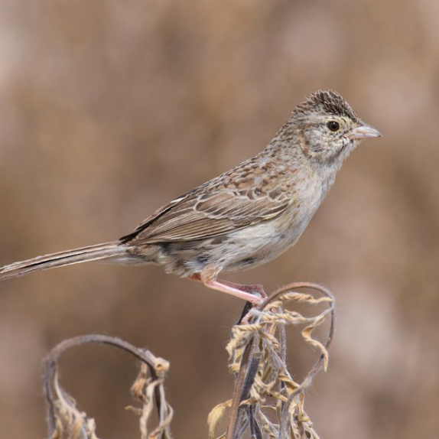

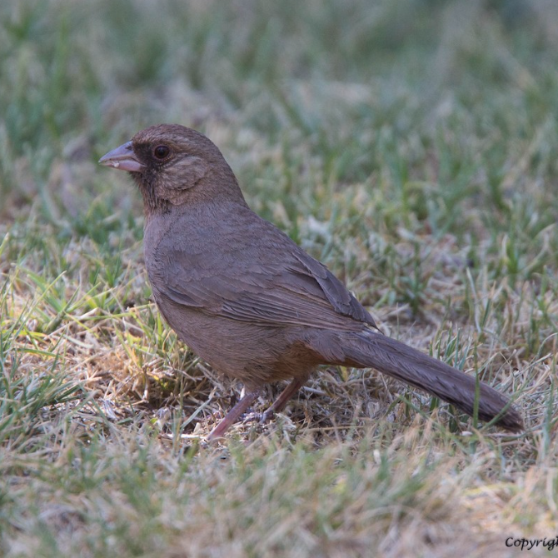
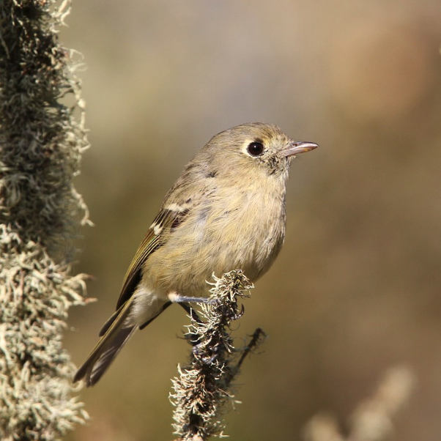
Species bias
Schuetz & Johnston 2019 PNAS
Notes:
Non-detections.
Basis for inferring absence

Slide 8
Challenges with eBird observation process
Spatial
bias
Variation
in protocol
Species
bias
Variation
in observers
FILTERING
ANALYSIS
Notes:
1. Filter/thin data to produce more structure
design-based estimates
2. Model the effects to control impact
model-based estimates

Slide 9
Variation in protocol
Checklist duration
Distance travelled
Time of day
Number of observers
Johnston et al. 2019 BioRXiv

Slide 10
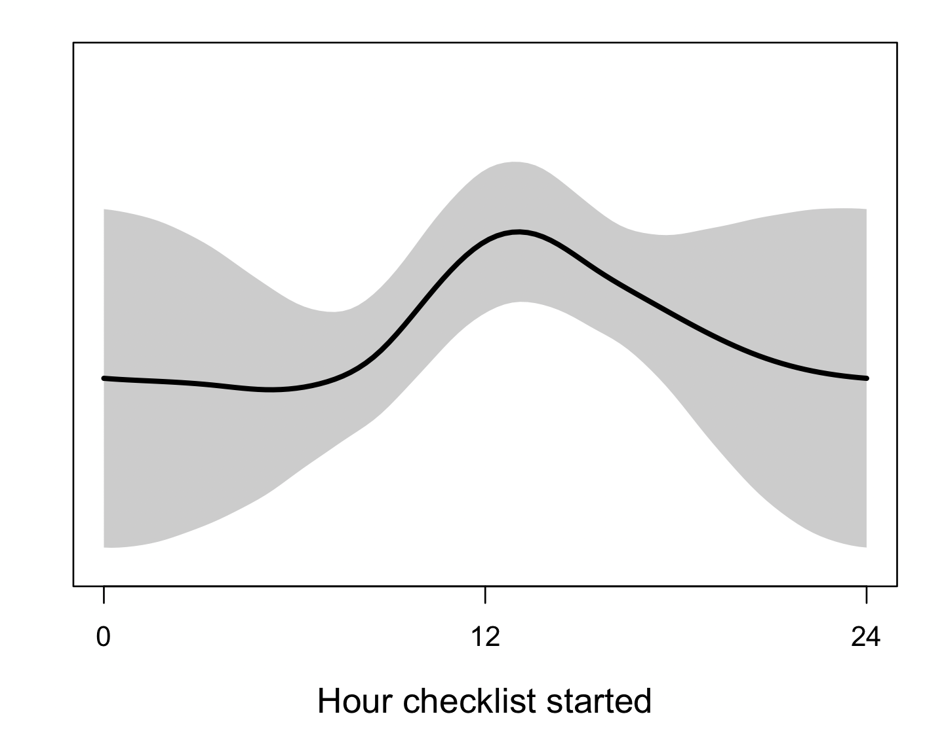
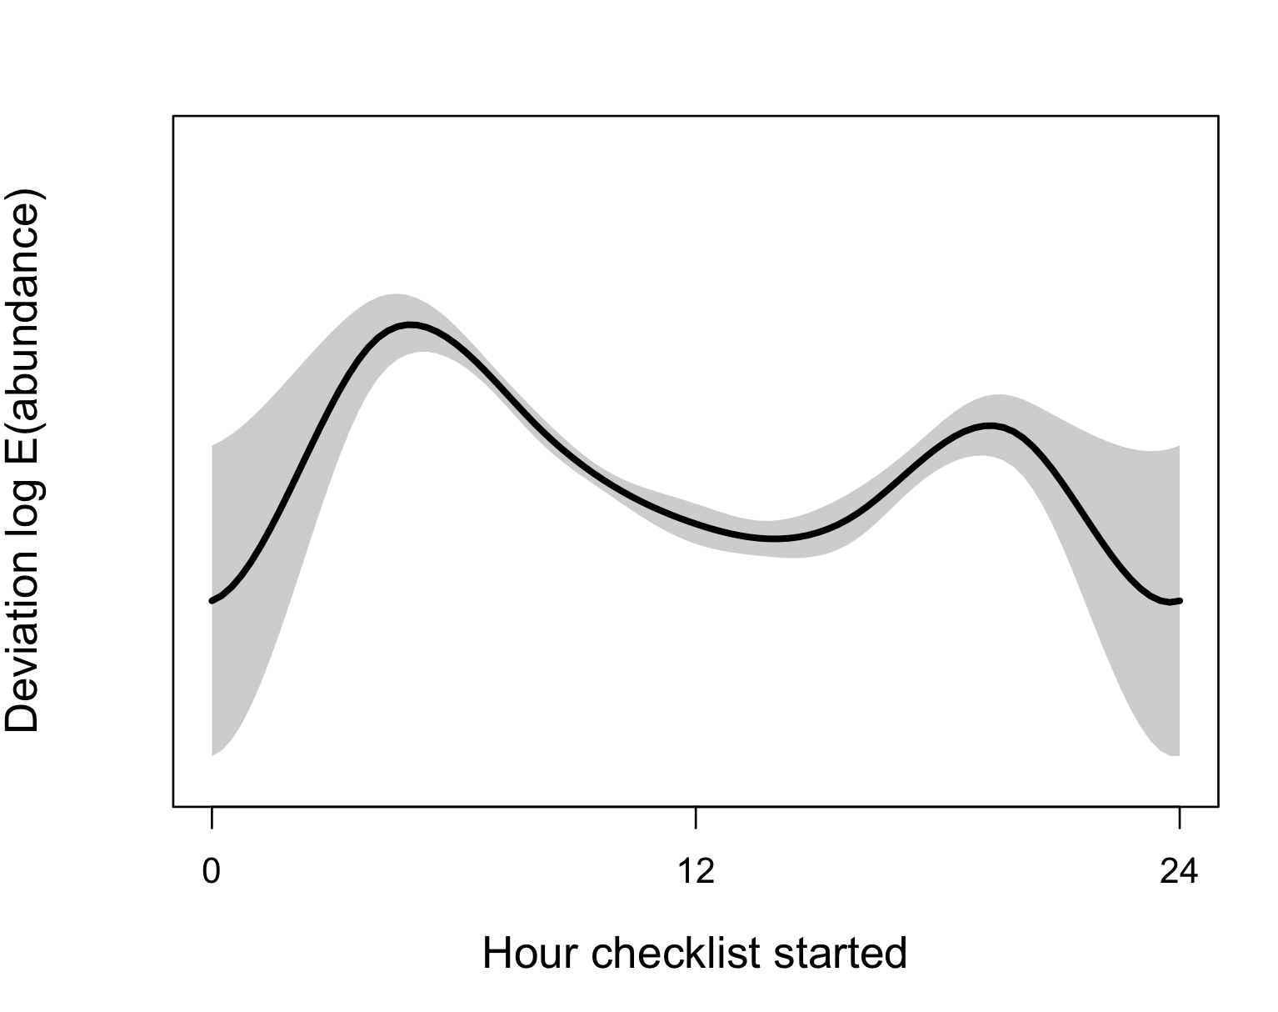
Variation in protocol
Northern pintail
Checklist duration
Distance travelled
Time of day
Number of observers
Species recorded on eBird checklist
Wood thrush
Johnston et al. 2019 BioRXiv

Slide 11
Challenges with eBird observation process
Spatial
bias
Variation
in protocol
Species
bias
Variation
in observers
FILTERING
ANALYSIS
Notes:
1. Filter/thin data to produce more structure
design-based estimates
2. Model the effects to control impact
model-based estimates

Slide 12
Advice for modelling eBird data
Model 1
Model 2
Model 3
Model 4
Model 5
Model 6
Use non-detections (absences)
Use complete lists
Spatial subsampling
Filter effort variables
Include effort variables as covariates

Slide 13
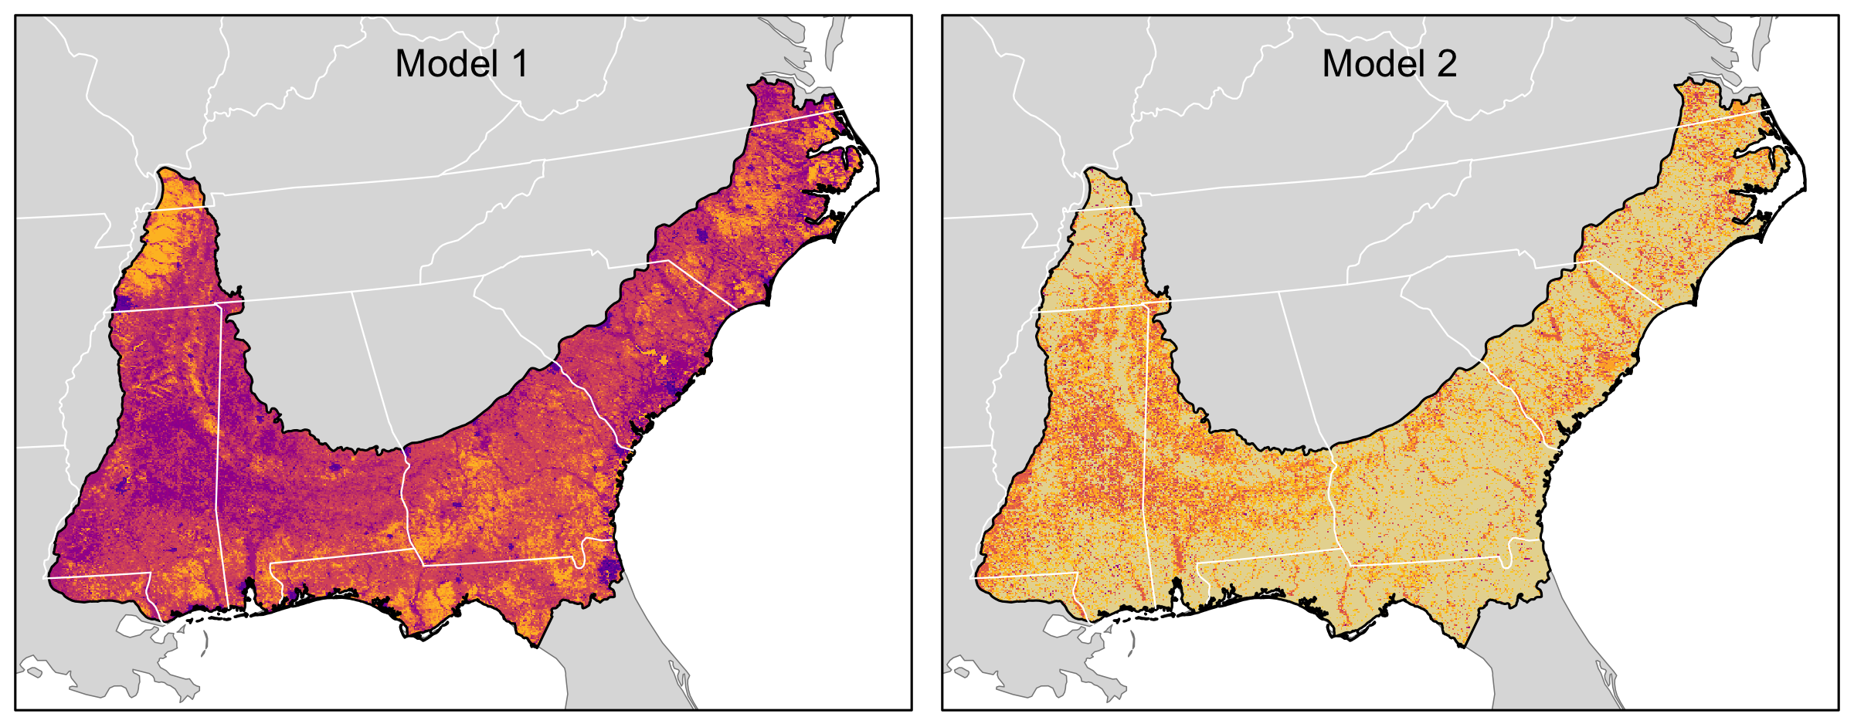
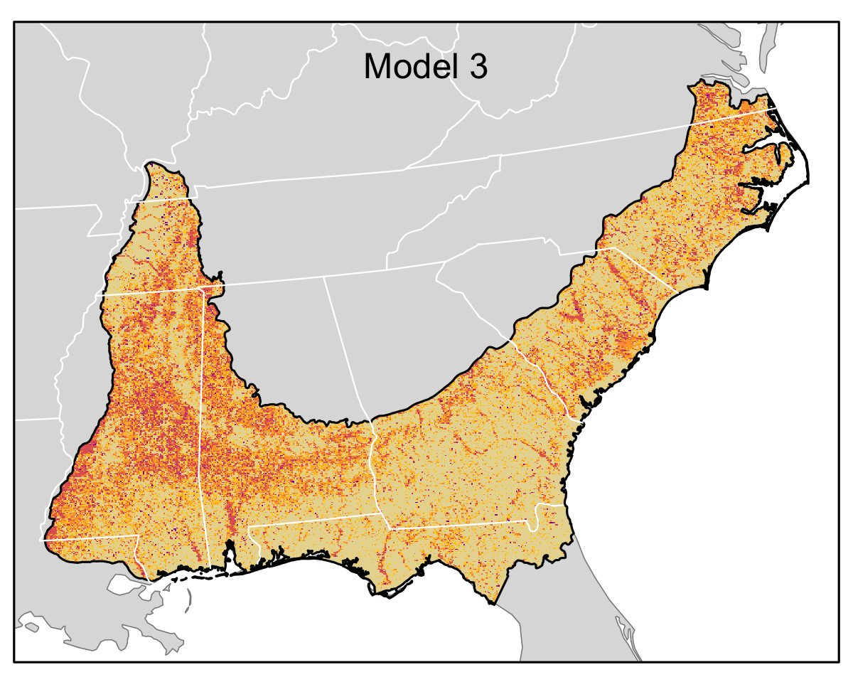
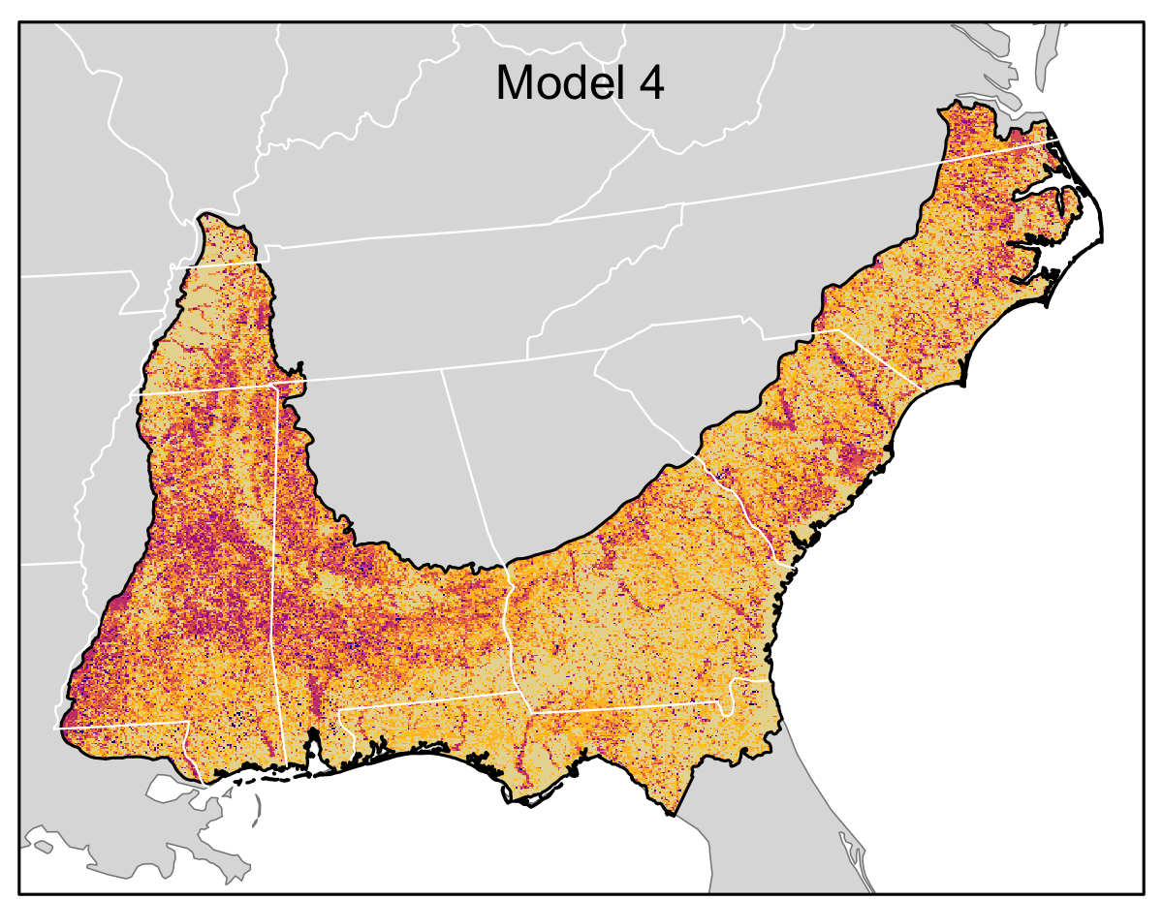
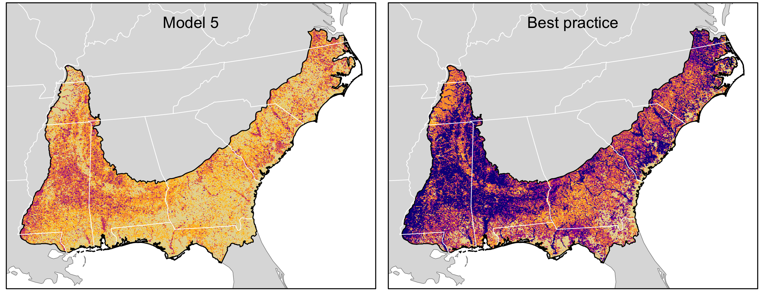
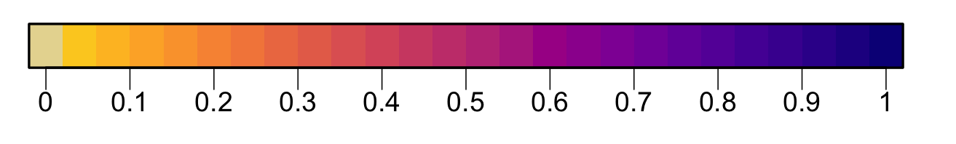
Encounter rate

Slide 14
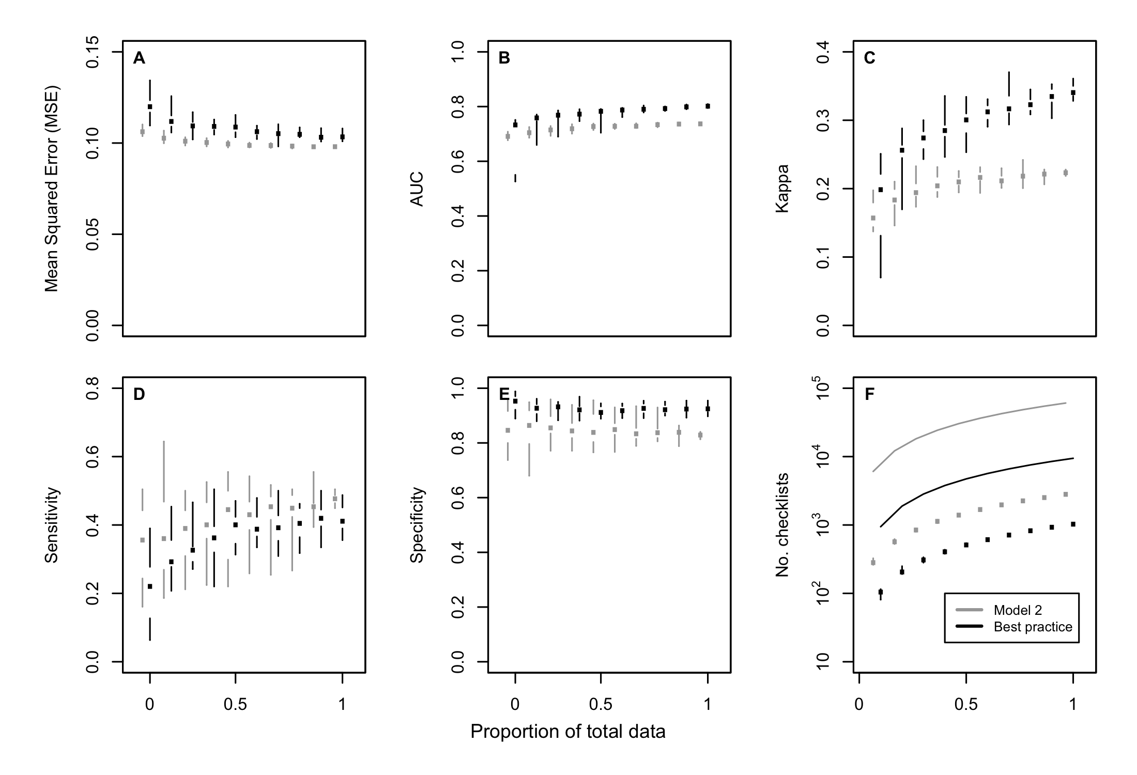

Slide 15
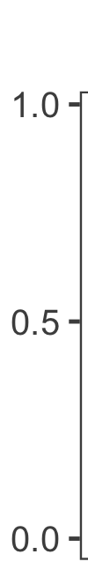
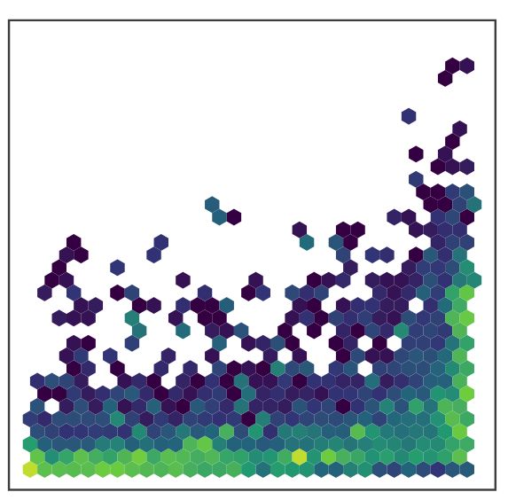
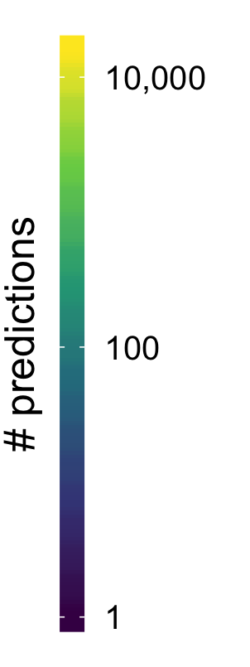
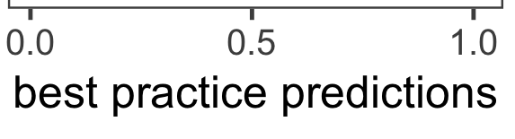
model 2 predictions

Slide 17
Advice for modelling eBird data
Model 1
Model 2
Model 3
Model 4
Model 5
Model 6
Use non-detections (absences)
Use complete lists
Spatial subsampling
Filter effort variables
Include effort variables as covariates
Johnston et al. 2019 BioRXiv

Slide 18
Variation in protocol
Filters
Checklist duration
Stationary/traveling
Distance travelled
Time of day
Number of observers
5 hours
Remove incidental
8km / 5 miles
All times
10

Slide 19
Best
Practices II
General principles for modeling

Slide 20
What do we want to know?
What can we estimate?
What are the gaps?

Slide 21
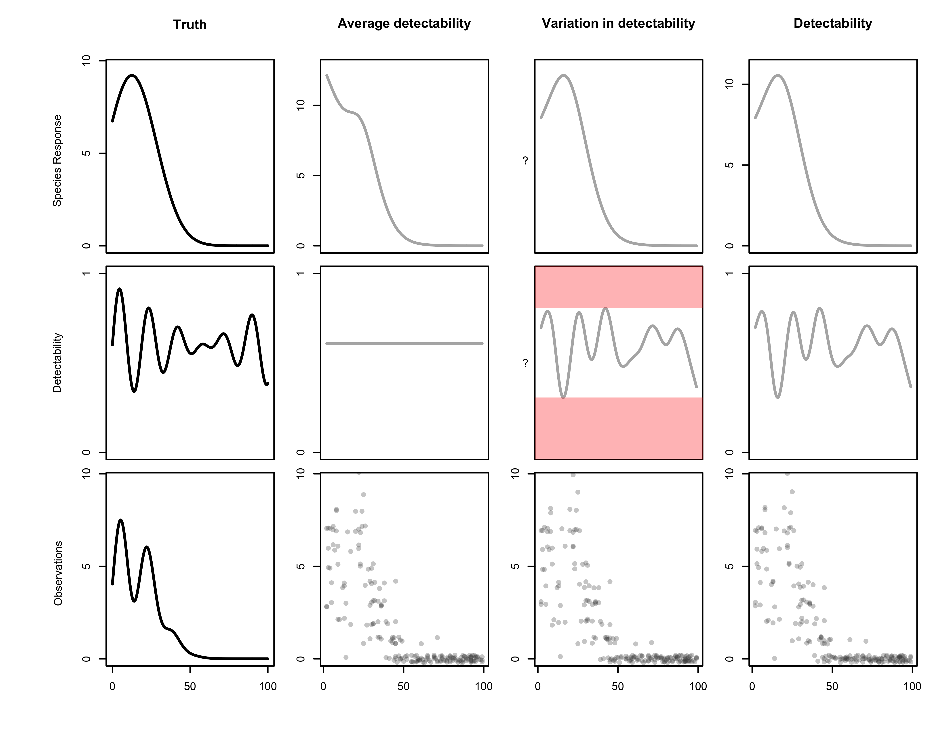
Species response
Detectability
Observations

Slide 22
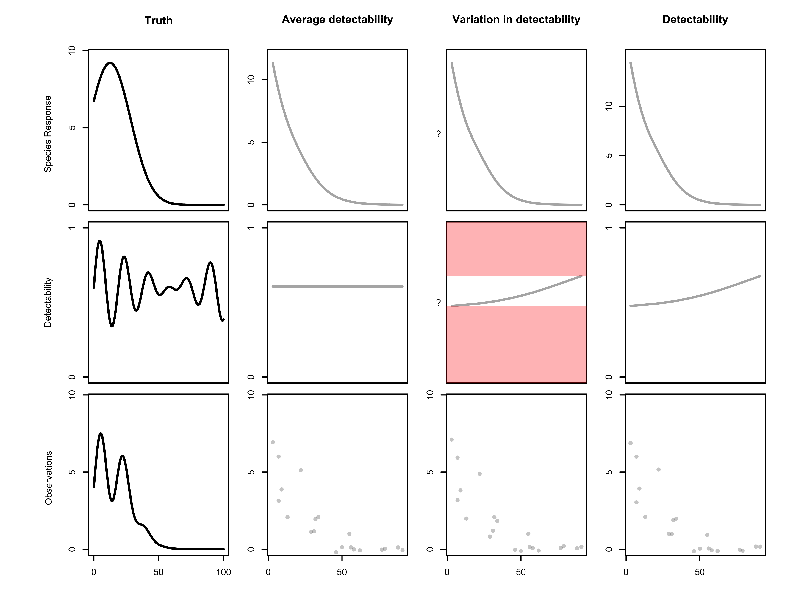
Species response
Detectability
Observations

Slide 23
What do we want to know?
What can we estimate?
What are the gaps?

Slide 24
Species response
Detectability
Occupancy modeling
Encounter rate
Occupancy modeling
Relative abundance

Slide 25
Simpler model structure
Parametric relationships
Complex model structure
Black box
Easier to fit
Simpler interpretation
More controlled structure
More realistic complexity
Closer fit to reality
ADVANTAGES
Inference
Explanation
Process
Prediction
Description
Pattern
BEST FOR

Slide 26
Simpler model structure
Parametric relationships
Complex model structure
Black box
Occupancy modeling
GAMs
Random forest
Inference
Explanation
Process
Prediction
Description
Pattern

Slide 27
Response data Detectability Complexity
Encounter rate
Occupancy
Relative abundance
Detection / non-detection
Detection / non-detection
Counts
Variation in detectability
Detectability AND variation in detectability
Variation in detectability
Describing patterns
Explaining processes
Pattern / process

Slide 28
Best
Practices II
General principles for modeling

